Slide 1
Building Smart Apps in Xamarin with Microsoft Cognitive Services
Carlos Miguel S. Quintos
Reynard C. Natividad
Microsoft Student Partners
Notes:
Greetings
Ask questions by C2
Introduction

Slide 2

Cognitive Services API Collection
Vision
Computer Vision | Emotion | Face | Video
Microsoft Cognitive Services
Give your apps a human side
Speech
Computer Recognition | Speaker Recognition Speech | Translator
Language
Bing Spell Check | Language Understanding Linguistic Analysis | Text Analytics | Web Language Model
Knowledge
Academic Knowledge | Entity Linking Knowledge Exploration | Recommendations
Search
Bing Autosuggest | Bing Image Search | Bing News Search | Bing Video Search | Bing Web Search
Notes:
That’s where MCS comes in!
MCS is based off years and years of research from Microsoft Research (which has over 1,000 scientists and engineers employed) that makes lots of really common tasks where you would use AI (like OCR or translation) easy
Project Oxford was announced at Build 2015 with 4 APIs, now 22 available.
Announced at build this year that there would be a free period, so all the APIs are free for you to try
Grouped into 5 sections: Vision, Speech, Language, Knowledge, and Search
Important to remember that you can combine individual APIs with others to create truly cognitive experiences

Slide 3

Microsoft Cognitive Services - apis
Why Microsoft Cognitive Services?
Easy
Flexible
Tested
Roll your own with REST APIs
SDKs via NuGet for most APIs
Simple to add: just a few lines of code required
Integrate into the language and platform of your choice
Breadth of offerings helps you find the right API for your app
Built by experts in their field from Microsoft Research, Bing, and Azure Machine Learning
Quality documentation, code, samples, and support
Notes:
Why Microsoft Cognitive Services?
Easy
All of the APIs are just REST APIs
SDK wrappers available on NuGet for most of the APIs, but should have a complete set soon
Flexible
Lots of offerings – 22 – of which you can combine to create even smarter apps
Tested
Several products at Microsoft are utilizing these APIs, and they have been on a monthly release cadence for fixing any issues
Lots of documentation, samples, and support

Slide 4
Vision
Computer Vision API
Face API
Emotion API
Video API
Distill actionable information from images
Detect, identify, analyze, organize, and tag faces in photos
Personalize experiences with emotion recognition
Analyze, edit, and process videos within your app
Notes:
Computer Vision API:
Tagging:
Get information from an image, such as a generic description of what’s happening in the photo, tagging (with associated confidence).
Works well with indoor/outdoor. Works well indoor/out with common objects. Doesn’t work with aerial images or super close-ups. Recognizing celebrities also pretty good!
OCR: Optimal Character Recognition
Works great for grabbing text from an image
Using this to build a consumer expenses app where people scan their receipts and automatically have values loaded in for them (similar to how Expensify works, but faster)
Thumbnails
If you have a large image, this puppy will grab you a thumbnail
Face API:
Detect all faces in a photo, face verification (given an image, is this who this is), facial identification (given a group, who is this?)
Also can learn age, gender, facial hair, etc.
Emotion API: Can detect eight specific emotions – based on universal facial expressions that are cross-cultural.
Video API: state of the art video processing algorithms to developers
Stabilization
Makes videos less shaky. Used in Hyperlapse app.
Face tracking
Track faces in a video
Motion Detection
Let you know when motion occurred and duration
Video Thumbnail: Take a long video, and automatically create a short preview clip.
Face tracking

Slide 5

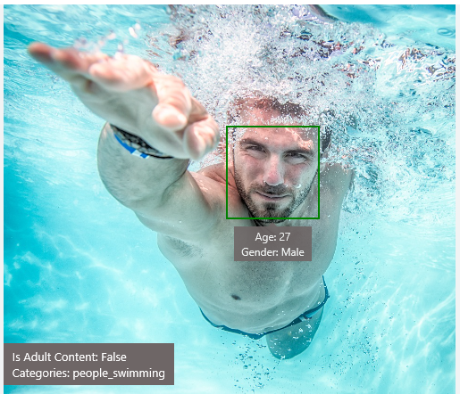
Analyze Image
Type of Image:
Clip Art Type 0 Non-clipart
Line Drawing Type 0 Non-Line Drawing
Black & White Image False
Content of Image:
Categories [{ “name”: “people_swimming”, “score”: 0.099609375 }]
Adult Content False
Adult Score 0.18533889949321747
Faces [{ “age”: 27, “gender”: “Male”, “faceRectangle”: {“left”: 472, “top”: 258, “width”: 199, “height”: 199}}]
Image Colors:
Dominant Color Background White
Dominant Color Foreground Grey
Dominant Colors White
Accent Color Blue
Notes:
Computer Vision API example here
CogS can detect the type of image (i.e. clip art and black and white),
tag actions in the photo (people_swimming) w/ confidence score
Is there adult content?
Tell you the faces in the photo, and some general info about them
Image colors
Colors in a photo

Slide 6

OCR
JSON:
{
"language": "en",
"orientation": "Up",
"regions": [
{
"boundingBox": "41,77,918,440",
"lines": [
{
"boundingBox": "41,77,723,89",
"words": [
{
"boundingBox": "41,102,225,64",
"text": "LIFE"
},
{
"boundingBox": "356,89,94,62",
"text": "IS"
},
{
"boundingBox": "539,77,225,64",
"text": "LIKE"
}
. . .
LIFE IS LIKE
RIDING A BICYCLE
TO KEEP YOUR BALANCE
YOU MUST KEEP MOVING
Notes:
Optical character recognition
Using this for building an expenses app right now.
Because these are just RESTful APIs, you can see we get back a nice JSON response from our RESTful service call

Slide 7
Speech
Bing Speech API
Speaker Recognition API
Custom Recognition Intelligent Service
Convert speech to text and back again, and understand its intent
Give your app the ability to know who's talking
Fine-tune speech recognition for anyone, anywhere
Notes:
Speech
State-of-the-art algorithms for processing spoken language powered by Bing. Supports seven languages right now, more coming every day.
Bing Speech API
Speech recognition – speech to text
Text to speech
Intent – not just words returned, but also intent
Speaker Recognition
Verification – is this the owner of this phone?
Xbox devs could have used this when people kept yelling “Xbox off” on multiplayer
Identification – For famous peoples, who is talking?
CRIS
Essentially, speech recognition on steroids.
Add custom language models by tailing to vocabulary of app and speaking style of useres
Acoustic models for matching in weird acoustic environments
Building app for dotNet devs to search MSDN
“object oriented” ”namespace” “dotNet” – have CRIS learn these

Slide 8
Language
Bing Spell Check API
Web Language Model API
Linguistic Analysis API
Language Understanding Intelligent Service
Text Analytics API
Detect and correct spelling mistakes within your app
Leverage the power of language models trained on web-scale data
Easily parse complex text with language analysis
Teach your apps to understand commands from your users
Detect sentiment, key phrases, topics, and language from your text
Notes:
Language
IMHO, one of the coolest parts of MCS.
Spell checking for text and provide accurate suggestions (contextually)
Trained using data from billions of web pages, updated super frequently
Web Language Model API
Work breaking
Next word completions, etc.
Linguistic Analysis API: The Linguistic Analysis API helps you gain insights from text. Given a natural language parse, it’s easy to identify the concepts and entities (noun phrases), actions (verbs and verb phrases), descriptive words, and more. The processed text can provide useful features for classification tasks such as sentiment analysis.
Based on a review a user has written, prepopulate the rating field with a suggested value based on their review
LUIS: Language Understanding Intelligent Service (LUIS) allows developers to build a model that understands natural language and commands tailored to their application.
Example: You can say “turn down the thermostat in the living room,” send it to a LUIS model, and instead of just returning the text that represents what was said, LUIS will return: the action is “turn down,” the location is “living room,” and the target is “thermostat.”
LUIS allows developers to iteratively build on these models and take speech or text input and return a structured representation of what the person said. Not only that but by build LUIS will help developers create and train smart conversational bot (Intercom or Slack) with a single button.
Key takeaway: speak, it’ll give you back the user’s intent. Pretty awesome.
You could quite literally build a Cortana / Siri / Google Now clone with this.
Text Analytics API:
Sentiment analysis
Key phrase detection
Building an app right now using this!
Take a photo of a passage, use OCR to get the text, and then use Text Analytics to highlight it for me.
Wish I had this in college!
Topic detection

Slide 9
Search
Bing Web Search API
Bing Autosuggest API
Bing Image Search API
Bing Video Search API
Bing News Search API
Connect powerful search to your apps
Give your app intelligent autosuggest options for searches
Bring advanced image and metadata search to your app
Trending videos, detailed metadata, and rich results
Link your users to robust and timely news searches
Notes:
This is the same tech that powers Bing/Xbox!
Web Search
Combination of all searches on the right
You get ranks for each piece of content. Depending on search, image, news, may be higher
Just like searching on a real webpage
Autosuggest
Verticals allow you to grab even more info
Very similar to Azure Search, but smarter
Provide recommendations to your user as they type (not just spellcheck, either)
Image Search
Only get images licensed under Creative Commons
Video Search
Get trending videos, detailed metadata, and rich results
Even video thumbnails
If we search for ”Kenny Chesney songs”, we can get 30 second thumbnails of music videos
News Search
Search for news content
Cool thing about cognitive services is you can use it just a little in your apps, or a lot. You could build a Flipboard clone with the News Search APIs

Slide 10
Knowledge
Update
Update
Academic Knowledge API
Knowledge Exploration Service
Entity Linking Service
Recommendations API
Explore relationships among academic papers, journals, and authors
Add interactive search over structured data to your project
Contextually extend knowledge of people, locations, and events
Provide personalized product recommendations for your customers
Notes:
Knowledge APIs: some of the coolest
Academic Knowledge:
Interpret queries for academic content
Get info about research papers, journals, conferences, etc.
Knowledge Exploration API: Bunch of advanced search APIs
Query evaluation
Natural language understanding
Attribute histograms
Entity Linking
Recognize entities in a body of text (each separate entity and it’s wikipedia entry)
Recommendations API
Provide recommendations to users
Item-to-Item recommendations: if you like X, you’ll also like Y. (Customers who bought this also frequently bought this)
Frequently Bought Together
Personalized User recommendations
Tons of implications for all types of apps – You can even build a “Friend Suggester” based off this, where the people represent both models and users

Slide 11
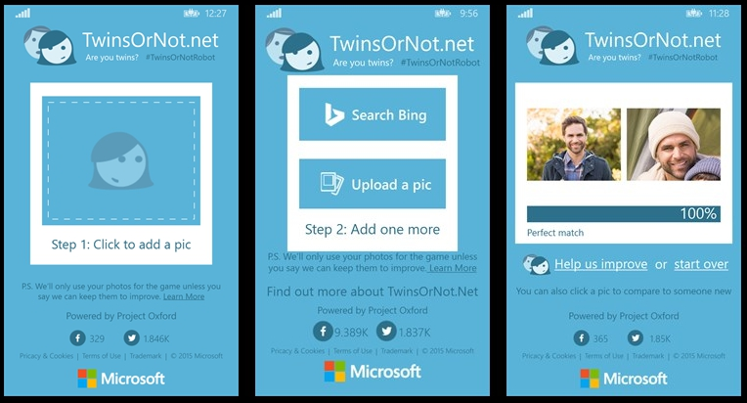
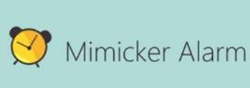
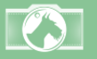
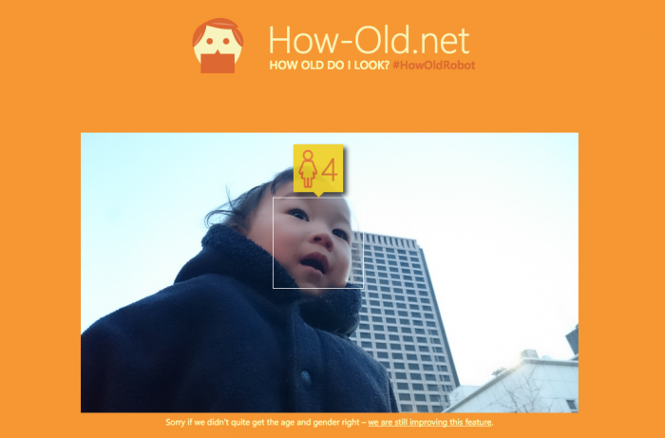

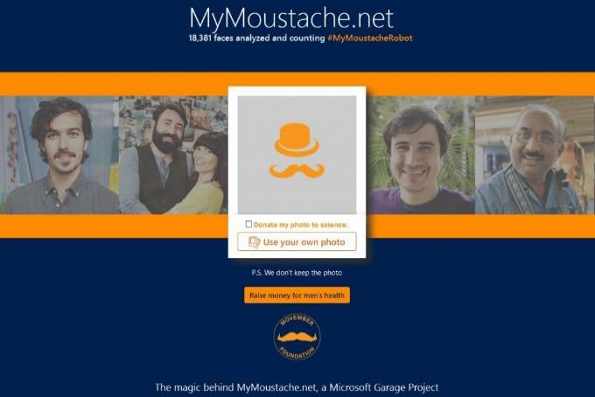
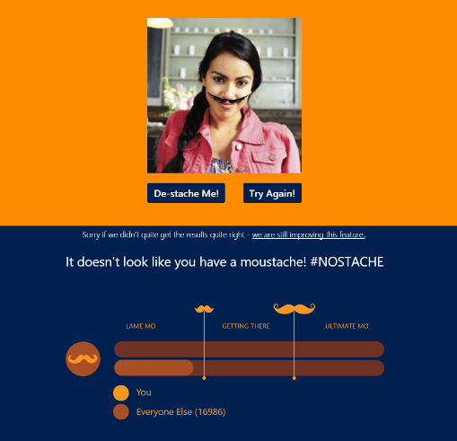
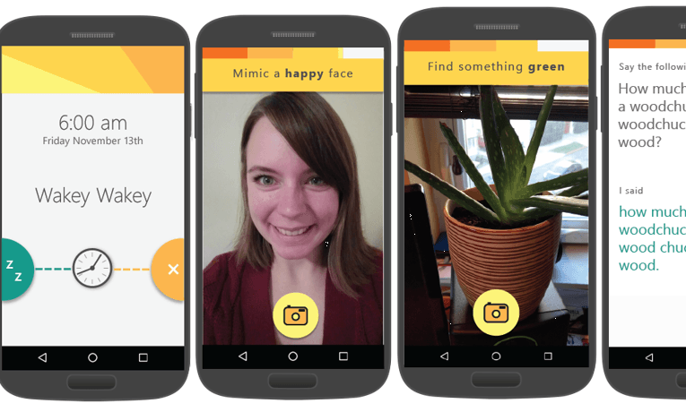

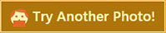
Fetch
showcase apps
Notes:
There are some great examples of apps built around Cognitive Services… You’ve probably played with a few of these before. Go try them out, and most are open source to dig into
My favorite is Mimicker alarm. Lots more coming! I’m working on making sure we have lots of mobile samples for these. If interested in helping out, let me know!

Slide 12

Get started for free at microsoft.com/cognitive
Notes:
All of these APIs are generously free to try right now.
You can start using these in production apps – to do so, contact me.

Slide 13
Thank you! Questions?
Carlos Miguel S. Quintos
Reynard C. Natividad
Microsoft Student Partners
Reynard.Natividad@StudentPartner.com
Carlos-Miguel.Quintos@StudentPartner.com
Notes:
Thanks so much!
Questions?

